Slide 1
Foundation of computer science
By Mohamed Agami

Slide 2

Lecture 14

Slide 3

Troubleshooting

Slide 4

Troubleshooting
Troubleshooting is a term that refers to the process of troubleshooting problems in systems, hardware, or software. The goal of this process is to identify the root cause of the problem and fix it to ensure that the system runs efficiently and smoothly. The troubleshooting process involves several steps to analyze the problem and test potential solutions until it is resolved.

Slide 5

How can I be good at troubleshooting?
Knowledge
Experience
Intuition

Slide 6
Troubleshooting by step
Identify
Identify the problem
Verify
Verify possible causes:
Attempt
Attempt simple solutions
Perform
Perform detailed diagnosis:
Apply
Apply the solution:
Verify
Verify the solution:
Prevent
Prevent future issues:

Slide 7

Troubleshooting Applications

Slide 8

A problem with an application might be caused by:
The Application
The Hardware
The Operating System
The Data
Other Applications In Conflict With This One
The User

Slide 9
General Steps for Solving Application Errors
Step 1: Interview the User and Back up Data
Interview the user and back up data.
Ask the user to reproduce the problem while you watch.
Try a reboot.

Slide 10
Step 2: Error Messages, the Web, Coworkers, and Logs Might Help
View error messages in the Action Center.
Use Event Viewer and Reliability Monitor to look for clues.
Find and ask for help.

Slide 11
Step 3: Consider the Data or the Application Is Corrupted
Consider data corruption.
Check application settings for errors.
Repair the application.
Uninstall and reinstall the application.

Slide 12
Step 5: Consider Windows Might Be the Problem
Download Windows updates.
Use System File Checker.
Boot Windows in Safe Mode.
Use System Restore.

Slide 13
Windows tools used to troubleshoot application problems

Slide 14


Windows tools used to troubleshoot application problems
MEMORY DIAGNOSTICS
(mdsched.exe)
System File Checker
sfc / scannow

Slide 15

Responding to Specific Error Messages

Slide 16
Responding to Specific Error Messages
When an Application Hangs (tasklist | more) (taskkill /f /pid:14812)
When a File Fails to Open
When the Application Has Never Worked

Slide 17
Troubleshooting Windows Startup

Slide 18
Understanding the Boot Process
Different Ways to Boot
A hard boot, or cold boot
A soft boot, or warm boot

Slide 19
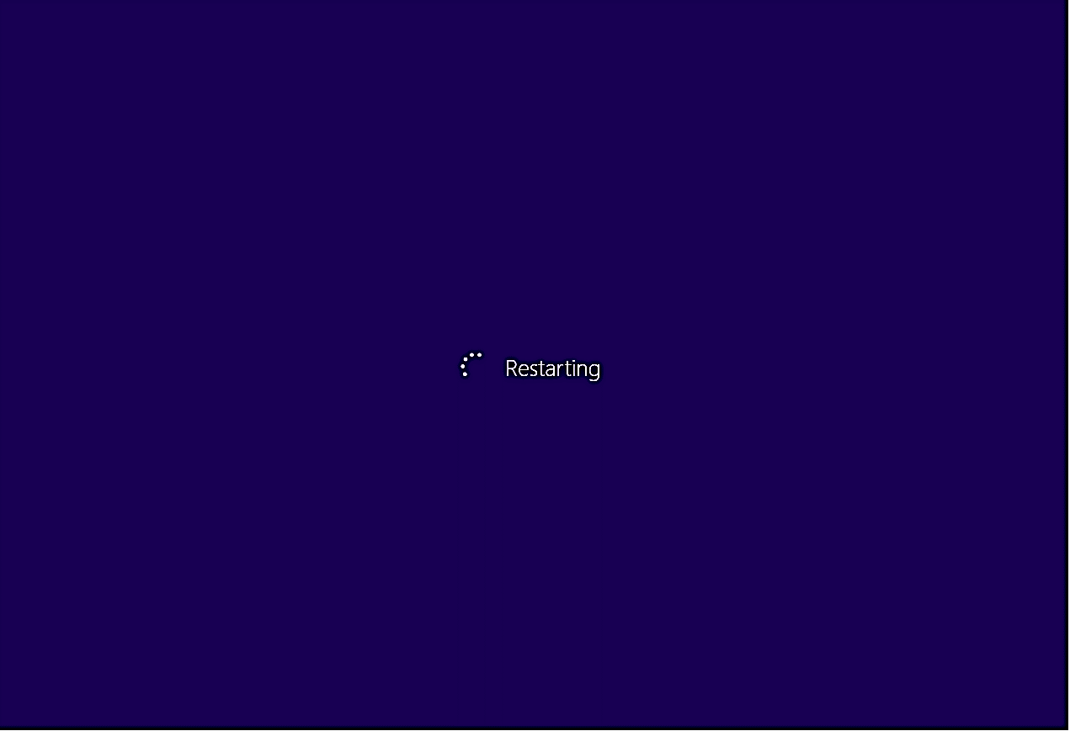
Windows Shutdown and Restart

Slide 20

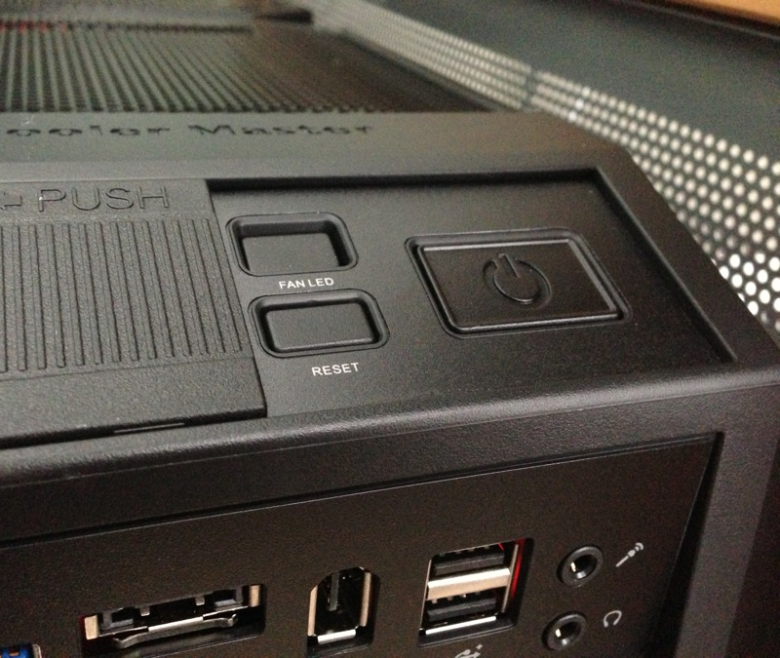
Power Buttons and Switches on a Computer Case

Slide 21
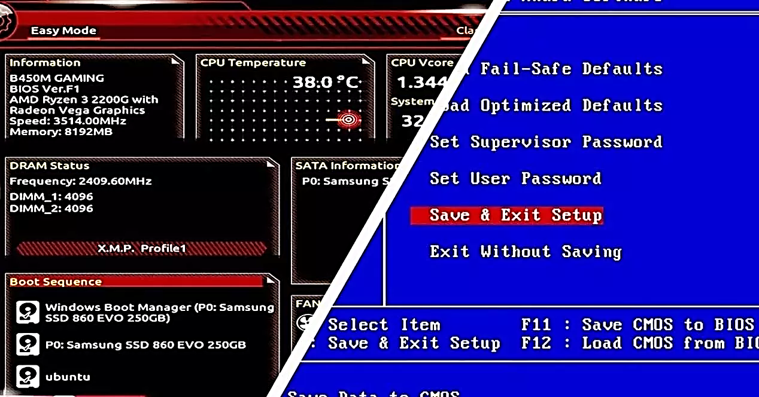
Startup UEFI/BIOS Controls the Beginning of the Boot

Slide 22
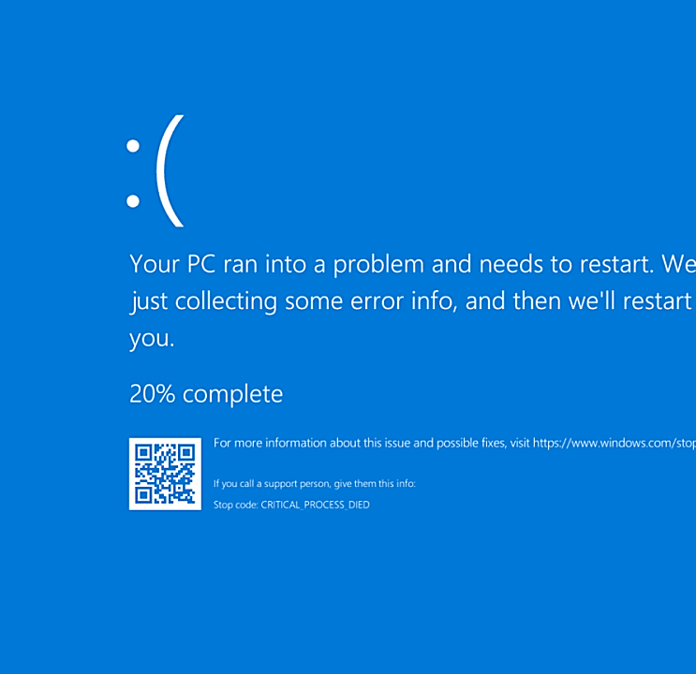
What is The Blue Screen of Death (BSOD)
is a critical system error screen that appears on Windows operating systems when the system encounters a severe problem that prevents it from continuing to operate safely. When a BSOD occurs, the computer stops working, displays a blue screen with an error message, and typically restarts automatically.

Slide 23
Cause
BSOD is usually triggered by hardware issues, faulty drivers, or low-level software errors.
Common causes include:
Faulty or incompatible device drivers.
Hardware problems like overheating, memory (RAM) issues, or failing hard drives.
Corrupt system files or registry entries.
Software conflicts, particularly in low-level applications (e.g., antivirus or firewall software).

Slide 24

Main Points to Solve Blue Screen of Death (BSOD)
Read the error code: Note the error code shown on the blue screen.
Enter Safe Mode: To verify if the issue is caused by software or drivers.
Update or Uninstall Drivers: Update or reinstall faulty drivers.
Scan the system for viruses: Check for malicious software.
Run Check Disk: Fix hard drive errors using the built-in tool.
Test the RAM: Check if the memory is functioning properly.
Uninstall recently installed programs: Remove any newly installed software that might be causing the issue.
System Restore: Restore the system to a previous point in time before the problem occurred.
Check device temperature: Ensure the system is not overheating.
Reinstall Windows: As a last resort if other solutions fail

Slide 25
Tank you

